Slide 1
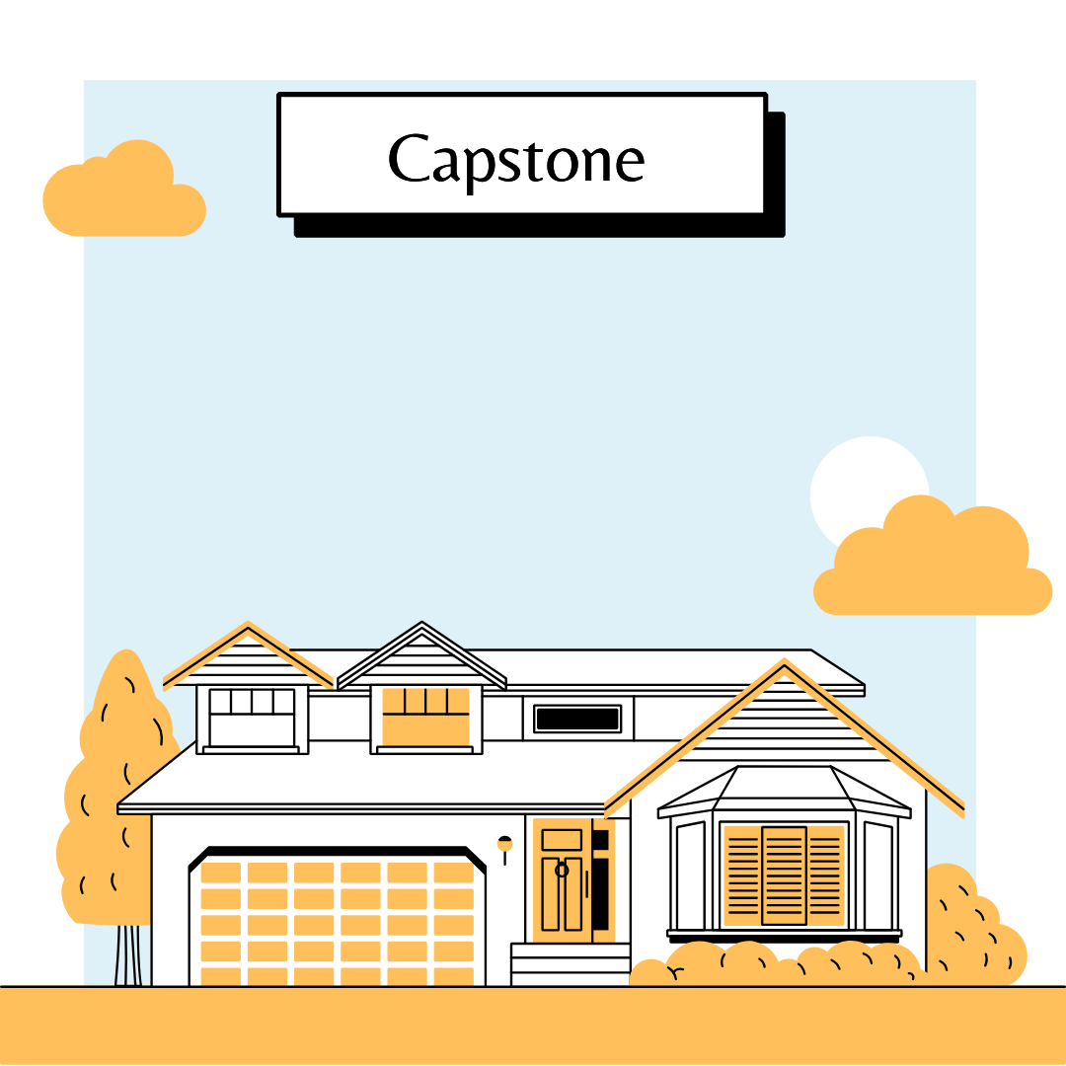
Aqaar recommendtion

Slide 2

introduction

Slide 3

Why property important to us?
1- Location, Location, Location : The area you choose matters.
2- Long-Term Planning: Look beyond the present. Consider your family or your job
3- Budget and Stretching: Determine your budget and stick to it.
4- Trade-Offs: Understand that no property is perfect.

Slide 4
objectives :
Our goal is to facilitate the process of choosing a property for the client and give a list of the most suitable neighborhoods for his needs.

Slide 5

objectives :
1- To build model that can classify Riyadh neighborhoods based on needs.
2- To develop a user-friendly interface for stakeholders to engage with the findings.

Slide 6
Collecting Data

Slide 7



Collecting Data of prices
البيانات المفتوحة

Slide 8

Collecting Data Schools& mosques

Slide 9
Data cleaning

Slide 10
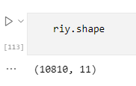
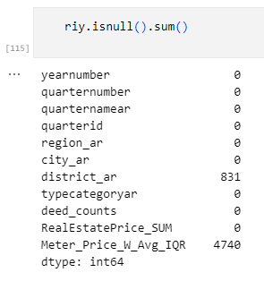
- 43% of meter price are missed

Slide 11
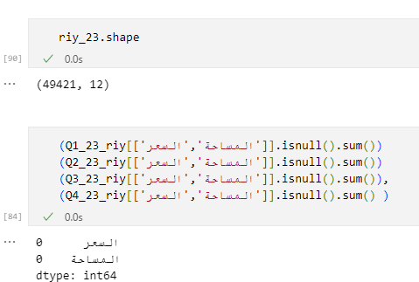

Slide 12
modeling

Slide 13
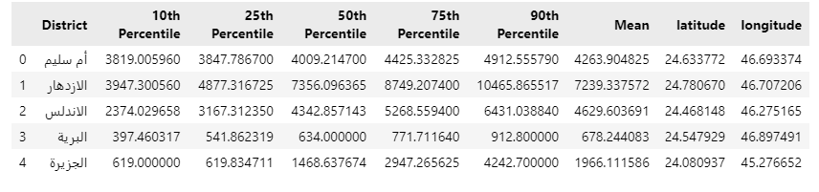
Data Aggregation

Slide 14
Knn model
Model selection
1- Similarity Measurement
2- Flexibility and Simplicity
3- Non-parametric Nature
4- Interpretability

Slide 15
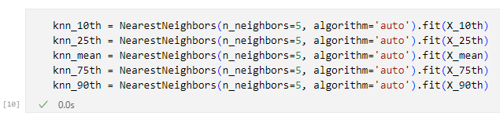
Knn model
Model selection
snapshot of model:
Evaluation :
Silhouette Score : 0.619825167419031

